Slide 1
EyeSea Analytics
Your Social Media Solution

Slide 2



The Social Media Conundrum
We use social media for everything… …including for things we should not
And employers are taking notice

Slide 3


EyeSea’s Solution
EyeSea takes the hassle out of social media management:
Lets you know what’s there
Lets you know what’s bad
Lets you know what to remove
See our app at https://www.eyesea.ml/

Slide 4

Target Market
Young professionals
Students
Influencers

Slide 5
Surveys and Interviews
Most popular are Instagram, Facebook, and Linkedin
91% of the total respondents post on social media more than once a year
40% of the total don’t review their posts before applying for job
60% of the total would like to have a service, out of which 92% are willing to pay

Slide 6

Competitors
Competitors like Webimax, GuaranteedRemovals, Reputation.ca
Mainly focus on businesses and HNWIs
Many services like removal of negative content, creating positive content, SEO
Very expensive! Monitoring negative content starts from $1200

Slide 7

Underlying Technology
Machine Learning models to identify problematic content and images
Fully automated report generation
Faster results
Pleasing and responsive user interface

Slide 8
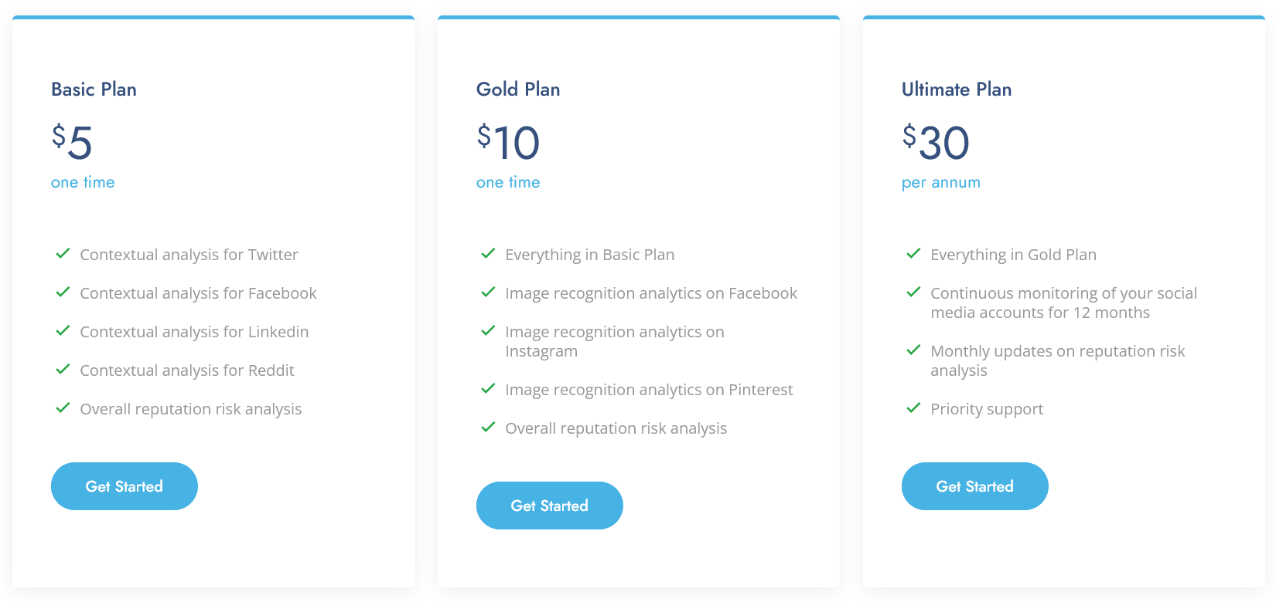
Business model

Slide 9
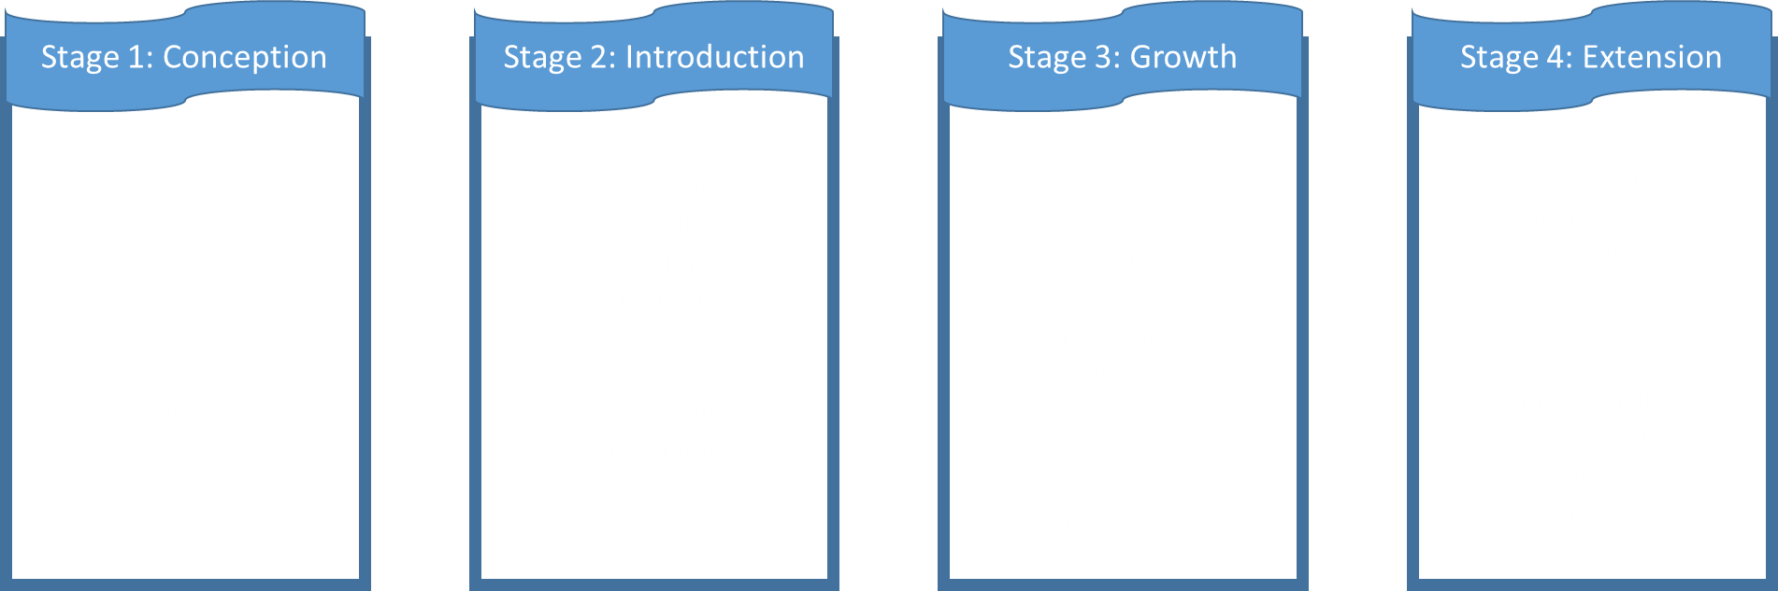

Projections and Milestones

Slide 10
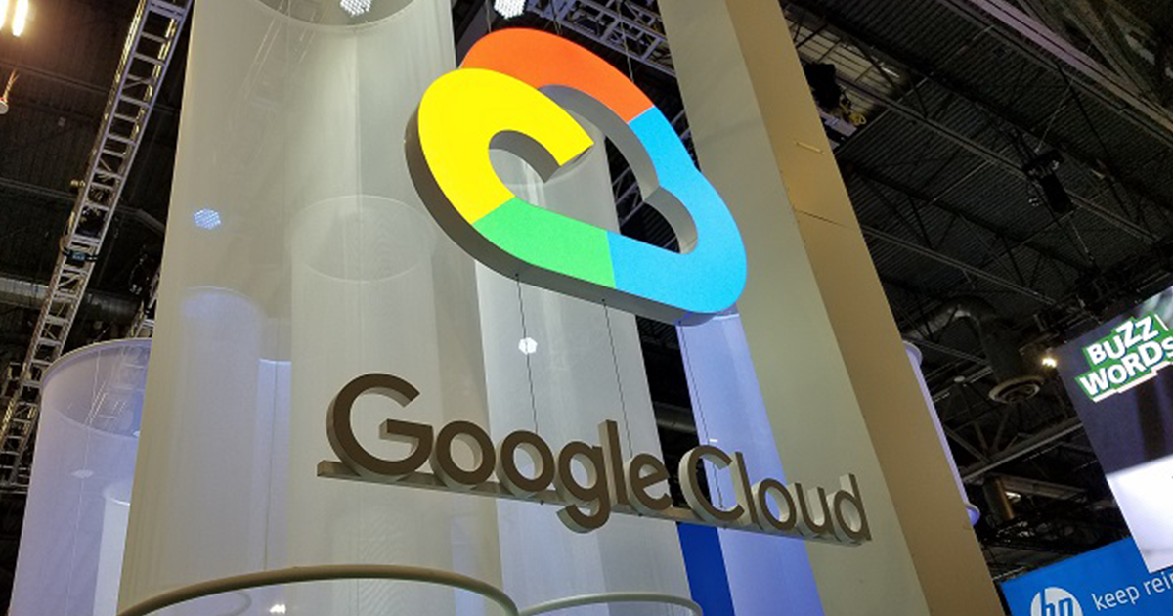
Summary and Ask
Minimum startup capital
Pay for what you consume and allows for scalability
Easy deployment
1 year projected financial net income of $ 169,484.94 CAD
Excited??????
What are you waiting for?
Our ask: $100,000 to cover development costs

Slide 11
Team
Thank you for listening!
Allen Ndonwi Shu
Bhavyai Gupta
Drew Burritt
Michael Man Yin Lee
Thomas Scott

Slide 12
Reference Links
https://uwaterloo.ca/arts-computing-newsletter/sites/ca.arts-computing-newsletter/files/uploads/images/social-media-tips-blog-header-no-logo.png
https://techcrunch.com/wp-content/uploads/2014/11/bullying-the-bullies-image.png
https://hiring-assets.careerbuilder.com/media/attachments/careerbuilder-ar_post-2186.jpg?1464648636
https://s.wsj.net/public/resources/images/BA-BQ674_Previe_F_20180303001633.jpg
https://unsplash.com/photos/g1Kr4Ozfoac
https://enterprisersproject.com/sites/default/files/styles/google_discover/public/2021-09/cio_automation_ai.png
https://www.pngitem.com/middle/ixJmmwx_transparent-clock-emoji-png-high-cost-icon-png/

